Slide 1
Cs-381 Software Engineering
Course Instructor: Dr. Shazia Arshad
Notes:
Welcome to all of you in this course. I am Dr. Shazia Arshad. I will be your instructor for this course.

Slide 2
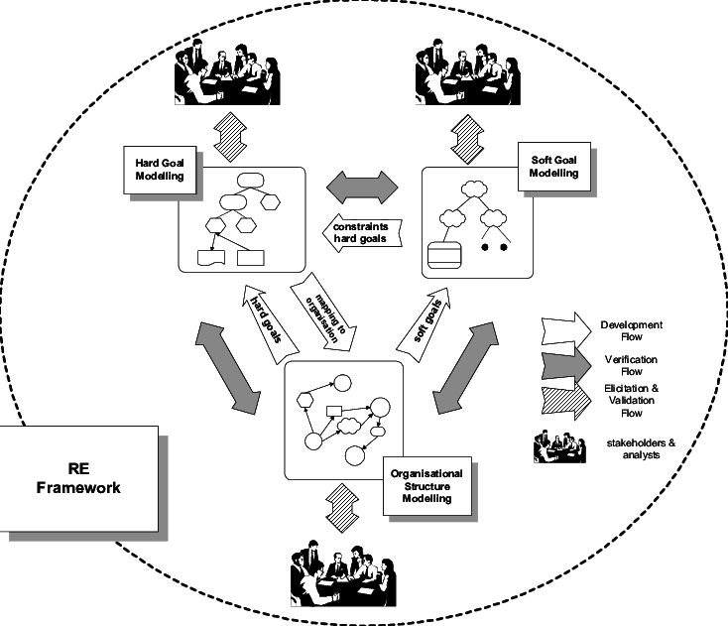
Requirement Engineering
Requirements engineering (RE) refers to the process of defining, documenting, and maintaining requirements in the engineering design process.
Requirements engineering processes ensures your software will meet the user expectations and ending up with a high-quality software.
Notes:
What does “software requirements engineering” mean exactly? While it is an integral phase in software engineering, it is not well understood. Software requirements engineering refers to the first phase, before any of the actual designing, coding, testing, or maintenance takes place. The goal is to create an important early document and process in the software design. Often referred to as software requirements specification, or SRS, it determines what software is produced. It is basically the gathering of information of a customer's or potential customer/target audience's requirements for a system, before any actual design takes place. Software requirements specifications give feedback to the potential customer, break down any problems into smaller parts, and also provide input toward the actual design. The customer will have clear information with the help of charts, flow charts, diagrams and tables to be certain that the software will serve the intended purpose.
Requirement Engineering is the process of defining, documenting and maintaining the requirements. It is a process of gathering and defining service provided by the system. It’s a critical stage of the software process as errors at this stage will reflect later on the next stages, which will cause you a higher cost. At the end of this stage, a requirements document that specifies the requirements will be produced and validated with the stockholders.

Slide 3
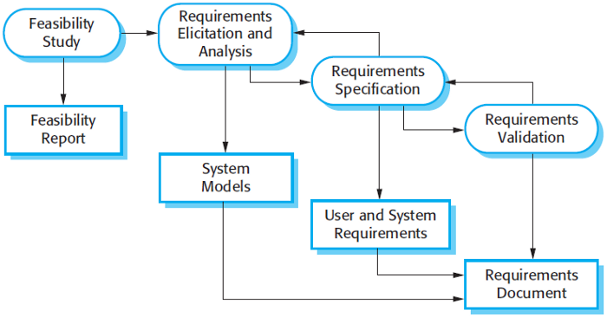
Requirement Engineering Process
Notes:
Activities of Requirement Engineering
Requirements Engineering Process consists of the following main activities:
Feasibility study: An estimate is made of whether the identified can be achieved using the current software and hardware technologies, under the current budget, etc. The feasibility study should be cheap and quick; it should inform the decision of whether or not to go ahead with the project.
Requirements elicitation and analysis: This is the process of deriving the system requirements through observation of existing systems, discussions with stakeholders, etc. This may involve the development of one or more system models and prototypes that can help us understanding the system to be specified. It is related to the various ways used to gain knowledge about the project domain and requirements. The various sources of domain knowledge include customers, business manuals, the existing software of same type, standards and other stakeholders of the project. The techniques used for requirements elicitation include interviews, brainstorming, task analysis, prototyping, etc. Elicitation does not produce formal models of the requirements understood. Instead, it widens the domain knowledge of the analyst and thus helps in providing input to the next stage.
Requirements specification: It’s the activity of writing down the information gathered during the elicitation and analysis activity into a document that defines a set of requirements. Two types of requirements may be included in this document: user and system requirements.
Requirements validation: It’s the process of checking the requirements for realism, consistency and completeness. During this process, our goal is to discover errors in the requirements document. When errors are found, it must be modified to correct these problems.
Of course, the activities in the requirements process are not simply executed in a strict sequence, but they are interleaved. For example, analysis activity continues during the specification as new requirements come to light.

Slide 4
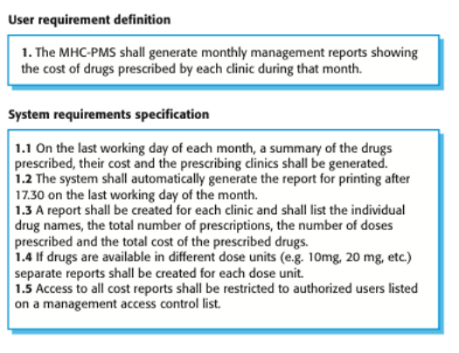
User and System REquirements
User Requirement:
Like a wish or feature
System Requirement:
Requirement is testable or not.
Notes:
User and System Requirements
User Requirements:
User Requirements, often referred to as user needs, describe what the user does with the system, such as what activities that users must be able to perform. User requirements are generally documented in a User Requirements Document (URD) using narrative text. User requirements are generally signed off by the user and used as the primary input for creating system requirements.
An important and difficult step of designing a software product is determining what the user wants it to do. This is because the user is often not able to communicate the entirety of their needs and wants, and the information they provide may also be incomplete, inaccurate and self-conflicting.
System Requirements:
The system requirements on the other hand are expanded version of the user requirements that are used by software engineers as the starting point for the system design.
They add detail and explain how the user requirements should be provided by the system. They shouldn’t be concerned with how the system should be implemented or designed.
The system requirements may also be written in natural language, but other ways based on structured forms, or graphical notations are usually used.
Example: The figure in the slide shows example of a MHC-PMS software. For that particular software, the user and system requirements are listed.
The first example of a "user requirement" is more like a wish or "feature." The way you can tell the difference between a feature and a requirement is that there's enough detail in the requirement to make it testable. Requirement 1 is not testable because, well, it's a wish. "I wish that the system had some reports for the managers." How do you know that the requirement has been achieved, that you can declare success?
Requirement 1.1 is testable because you can wait until the last working day of the month and see if a report is generated on that day (or you can inject dates into the system and observe its behavior).
Other requirements are testable for the same reasons.

Slide 5
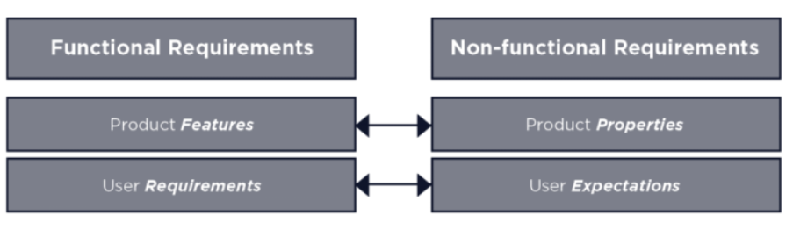
Functional and Non-Functional Requirements
Notes:
Functional Requirements:
Functional requirements define the basic system behavior. Essentially, they are what the system does or must not do and can be thought of in terms of how the system responds to inputs. Functional requirements usually define if/then behaviors and include calculations, data input, and business processes. Functional requirements are features that allow the system to function as it was intended. Put another way, if the functional requirements are not met, the system will not work. Functional requirements are product features and focus on user requirements.
Non-Functional Requirements:
While functional requirements define what the system does or must not do, non-functional requirements specify how the system should do it. Non-functional requirements do not affect the basic functionality of the system (hence the name, non-functional requirements). Even if the non-functional requirements are not met, the system will still perform its basic purpose.
If a system will still perform without meeting the non-functional requirements, why are they important? The answer is usability. Non-functional requirements define system behavior, features, and general characteristics that affect the user experience. How well non-functional requirements are defined and executed determines how easy the system is to use and is used to judge system performance. Non-functional requirements are product properties and focus on user expectations.

Slide 6
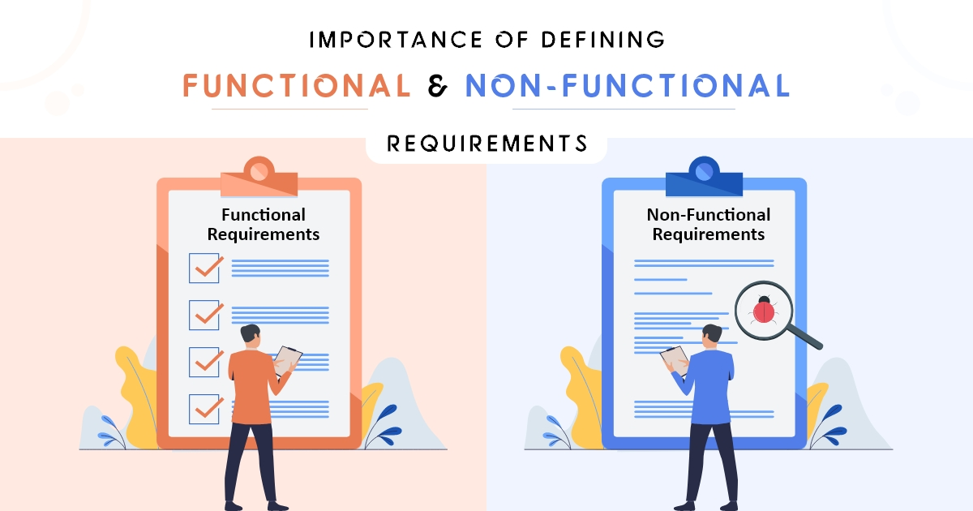
Examples of FUNCTIONAL AND NON-FUNCTIONAL REQUIREMENTS
Example:
School Management System
Users:
Admin
Teachers
Student
Notes:
Functional and Non-Functional Requirements Example
Consider the example of a school management system. The goal of this system is to automate the school related activities. For this system, there are three main prominent users:
Admin
Teachers
Students
The functional requirements are as follows:
Admin:
Admin shall be able to login.
Admin shall be able to manage classes and sections.
Admin shall be able to manage teachers.
Admin shall be able to manage students.
Admin shall be able to review attendance of teachers and students.
Admin shall be able to manage courses.
Admin shall be able to manage timetable.
Teacher:
Teacher shall be able to login.
Teacher shall be able to mark and view attendance.
Teacher shall be able to manage student results.
Teacher shall be able to view timetable.
Teacher shall be able to view payroll
Teacher shall be able to view date sheet of exam.
Teacher shall be able to upload and manage assignments.
Students:
Student shall be able to login.
Student shall be able to view academic details.
Student shall be able to view timetable.
Student shall be able to view fee information
Student shall be able to view date sheet of exam.
Student shall be able to view and submit assignments.
The non-functional requirements are as follows:
Easy to use interface
Able to manage large data
Should not crash.

Slide 7
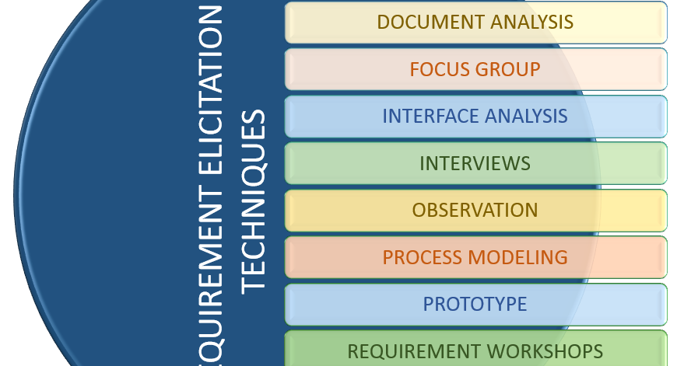
Requirement Elicitation Techniques
Document analysis
Interviews
Brainstorming
Observation
Notes:
Requirement Elicitation Techniques
Document analysis: Document analysis involves gathering and reviewing all existing documentation that is important to your business objective or that may hold data related to a relevant solution. Such documentation may include, “business plans, market studies, contracts, requests for proposal, statements of work, existing guidelines, procedures, training guides, competing product literature, published comparative product reviews, problem reports, customer suggestion logs, and existing system specifications, among others.” In other words, virtually anything that is written related to the project may be useful. This type of elicitation is especially useful when the goal is to update an existing system or when the understanding of an existing system will enhance a new system.
Interviews: One-on-one interviews are among the most popular types of requirements elicitation, and for good reason: they give an analyst the opportunity to discuss in-depth a stakeholder’s thoughts and get his or her perspective on the business need and the feasibility of potential solutions. “Research has found that interviews . . . are the most effective way of eliciting requirements.” Whether an analyst chooses to have a structured (with predefined questions) or unstructured interview (with free-flowing, back-and-forth conversation), she must fully understand the business need in order to conduct a successful interview.
Brainstorming: This technique is used to generate new ideas and find a solution for a specific issue. The members included for brainstorming can be domain experts, subject matter experts. Multiple ideas and information give you a repository of knowledge and you can choose from different ideas. This session is generally conducted around the table discussion. All participants should be given an equal amount of time to express their ideas. Brainstorming technique is used to answer the below questions:
What is the expectation of a system?
What are the risk factors that affect the proposed system development and what to do to avoid that?
What are the business and organization rules required to follow?
What are the options available to resolve the current issues?
What should we do so that this particular issue does not happen in the future?
Observation: This elicitation technique helps in collecting requirements by observing users or stakeholders. This can provide information about the exiting process, inputs and outputs. There are two kinds of observations — active and passive. In active observation, the business analyst directly observes the users or stakeholders, whereas in passive observation the business analyst observes the subject matter experts. This helps the business team understand the requirements when users are unable to explain requirements clearly.

Slide 8
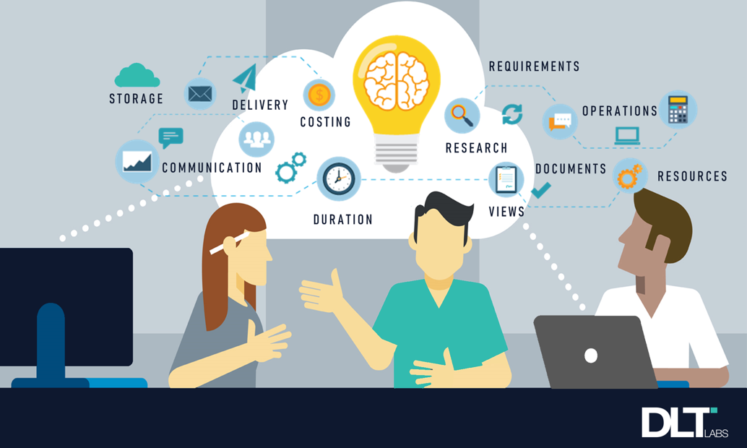
REQUIREMENT ELICITATION TECHNIQUES
Workshops
Focus Group
Prototyping
Survey/Questionnaire
Notes:
Requirement Elicitation Techniques Continue
Workshops: Workshops comprise a group of users or stakeholders working together to identify requirements. A requirement workshop is a structured way to capture requirements. Workshops are used to scope, discover, define, and prioritize requirements for the proposed system. They are the most effective way to deliver high-quality requirements quickly. They promote mutual understanding and strong communication between users or stakeholders and the project team.
Focus Group: By using a focus group, you can get information about a product, service from a group. The Focus group includes subject matter experts. The objective of this group is to discuss the topic and provide information. If a product is under development and the discussion is required on that product then the result will be to update the existing requirement, or you might get new requirements. If a product is ready to ship, then the discussion will be on releasing the
How Focus groups are different than group interviews?
A Focus group is not an interview session conducted as a group; rather it is a discussion during which feedback is collected on a specific subject. The session results are usually analyzed and reported. A focus group typically consists of 6 to 12 members. If you want more participants then create more than one focus group.
Prototyping: Prototyping is used to identify missing or unspecified requirements. In this technique, frequent demos are given to the client by creating the prototypes so that client can get an idea of how the product will look like. Prototypes can be used to create a mock-up of sites, and describe the process using diagrams.
Survey/Questionnaire: For Survey/Questionnaire, a set of questions is given to stakeholders to quantify their thoughts. After collecting the responses from stakeholders, data is analyzed to identify the area of interest of stakeholders. Questions should be based on high priority risks. Questions should be direct and unambiguous. Once the survey is ready, notify the participants and remind them to participate. Two types of questions can be used here: Open-Ended: Respondent is given the freedom to provide answers in their own words rather than selecting from predefined responses. This is useful but at the same time, this is time- consuming as interpreting the responses is difficult. Close Ended: It includes a predefined set of answers for all the questions and the respondent must choose from those answers. Questions can be multiple choice or can be ranked from not important to very important.

Slide 9
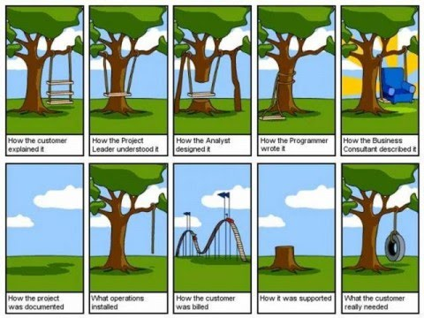
Requirement Document
Notes:
Requirement Document
The importance of requirement definition can be understood from the slide. It clearly shows how different users understand the project in different ways. It clearly shows the difference
How the customer explained project?
How the project leader understood it?
How the analyst designed it?
How the programmer wrote it?
How the business consultant described it?
How the project was documented?
What the customer really needed?
The software requirements document (also called software requirement specification or SRS) is an official document of what should be implemented. It’s also used as a contract between the system buyer and the software developers.
It should include both, user and system requirements. Usually, the user requirements are defined in an introduction to the system requirements.
The structure of requirement document or SRS is as follows:
Introduction
General Description
Requirements (both functional and non-functional, Use-Cases)
Methodology

Slide 10

TIME TO THINK
Write down functional and non-functional requirements for your project.

